Slide 1

2019-11-04
Community Detection in Large Transport Networks
Anna Lokrantz

Slide 2
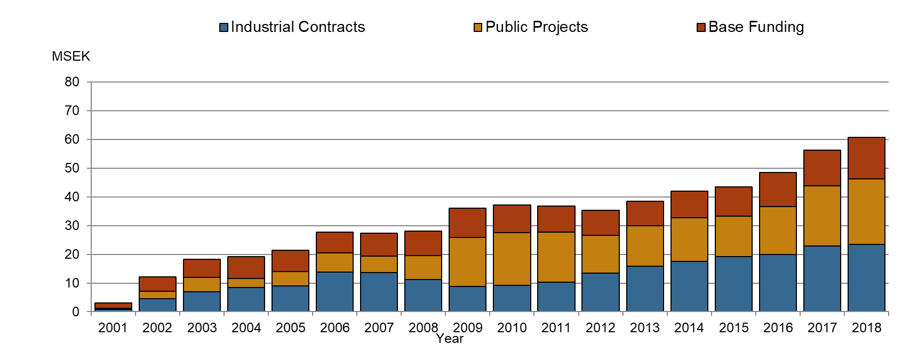
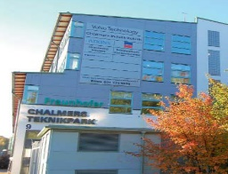
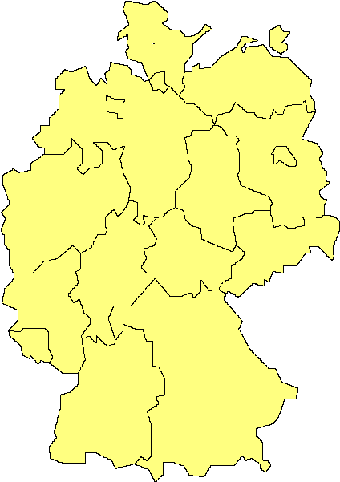
FRAUNHOFER-CHALMERS CENTRE
Basic
funding
Founded September 2001 by Fraunhofer and Chalmers
Offers applied mathematics for a broad range of industrial applications
Projects defined by companies and public institutes on a commercial basis
Pre-competitive research and marketing with financing from our founders
Systems and Data Analysis, Geometry and Motion Planning, Computational Engineering
Fraunhofer
1/6
Chalmers
1/6
FCC
1/3
1/3
Industry
projects
EU
grants
Public
grants
Fraunhofer-Gesellschaft 2018
72 research units
& institutes
Itzehoe
Rostock
Bremen
Hannover
Braunschweig
Golm
Berlin
Oberhausen
Magdeburg
26 600 employees
Duisburg
Dortmund
Aachen
Schmallenberg
Dresden
Euskirchen
St. Augustin
Jena
Chemnitz
Darmstadt
Würzburg
Kaiserslautern
Erlangen
St. Ingbert
Saarbrücken
Karlsruhe
2.6 billion € turnover
Pfinztal
Freising
Freiburg
Stuttgart
München
Holzkirchen
Chalmers AI Research Center (CHAIR)
AI Innovation of Sweden (AI.se), Fraunhofer Center for Machine Learning (FhCML)

Slide 3
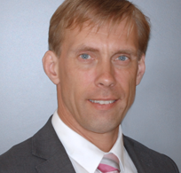

The department develops simulation technology
for automatic path-planning and line-balancing, sealing,
virtual paint, flexible materials, metrology, and
intelligently moving manikins.
The department works on numerical methods
for fast algorithms and engineering tools to support
virtual product and process development.
Applications include fluid dynamics, structural
mechanics, and electromagnetics.
The department offers competence in dynamical
systems modeling, pharmacometrics, systems
biology and electrophysiology, machine
learning, AI, and big data analytics.
.

Slide 4

About me
28 years old, from Gothenburg.
Chalmers
  BSc Chemical engineering with engineering physics.
  MSc Engineering Mathematics and Computational Science.
Exchange studies at the University of Aberdeen, Scotland.
At FCC since March 2017.
Climbing, hiking, cycling, running, skiing…

Slide 5
About the project
Collaboration with Scania.
HUGE amounts of GPS data from lorries.
Can we identify the ”usage” of vehicles from their stopping and driving behaviour?
  Example: dustcart/garbage truck
Upsell, better service, customise lorries etc.

Slide 6
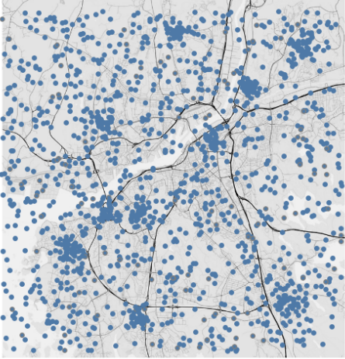
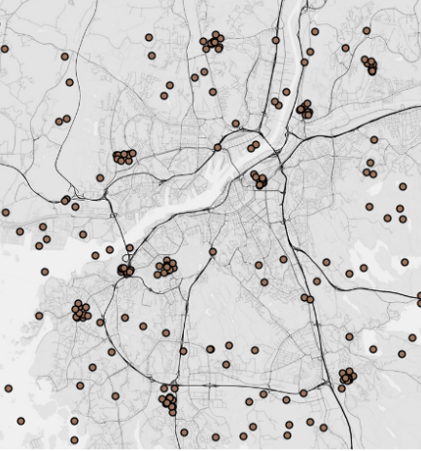
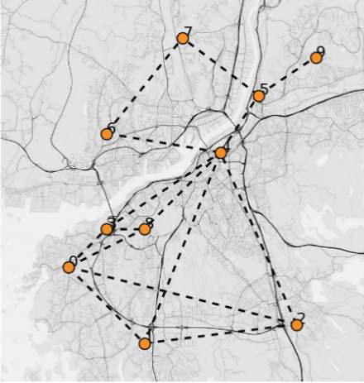
The Scania data, from positions to network
Positions
Stops
Hub sequences

Slide 7
Community detection in networks
A community: a group of nodes with more connections among its members than to other nodes in the network.
Practical interpretations: organisational units in social networks, ecological niches in food web networks…
Communities can overlap. The more communities a pair of nodes share, the more likely that they are connected in the network.
Different algorithms.

Slide 8
Overlapping community detection on Scania data
In this case, data from vehicles driving in Europe manufactured in 2018
A model for scalable, overlapping community detection
The model is fitted to the transportation network.

