Slide 1
Jonathan Ahlstedt
Notes:
Hej Hej,
Jonathan Ahlstedt heter jag och jag är här för att prata lite om hur det är att jobba som utvecklare på Zenuity.

Slide 2
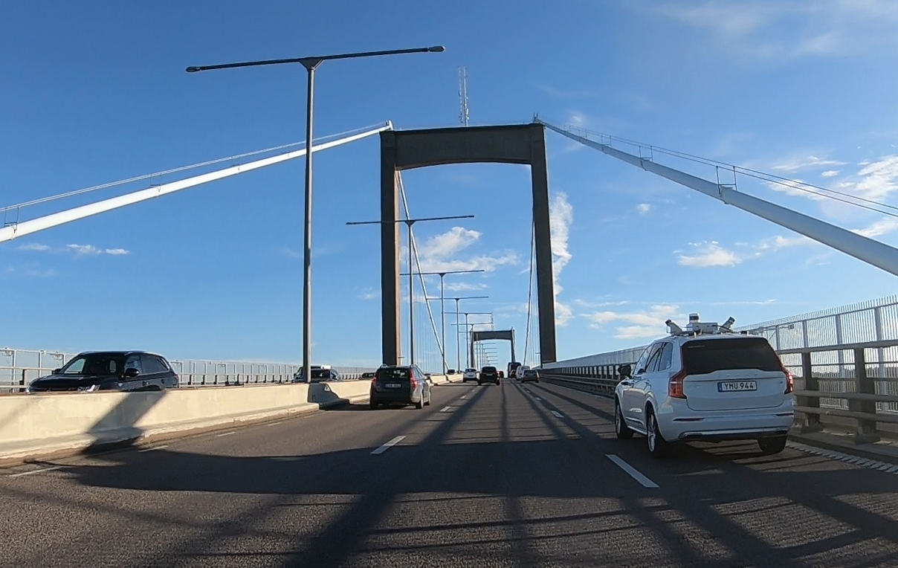
Validating sensors in self-driving cars
Company and team introduction
System setup
Object tracking
Lane detection
A day at work
Features in development

Slide 3


OUR PURPOSE IS TO MAKE IT REAL
Cloud
Real-time HD Maps l Connected Safety Functions
Sensor
Sensing Sensor Fusion Decision & Control Vehicle Control
Actuator
Base Tech Software l HW Design l System Design l Technical Safety Concepts
System

Slide 4
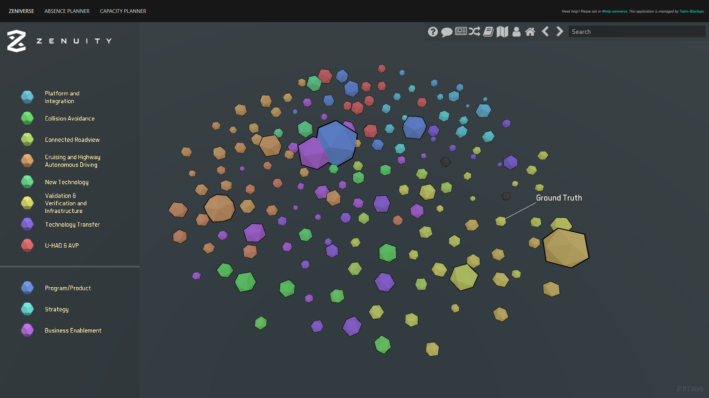
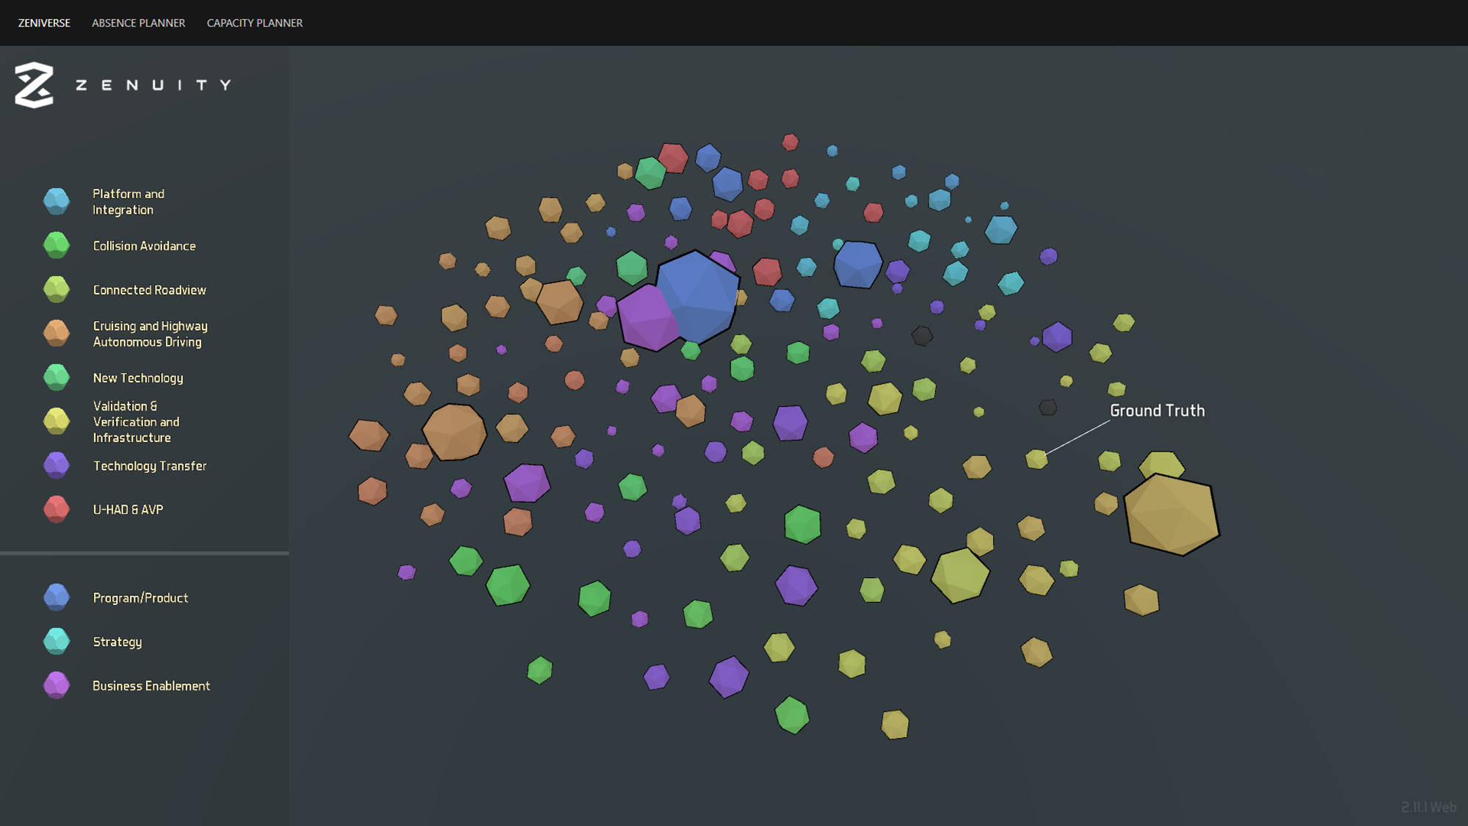

Slide 5

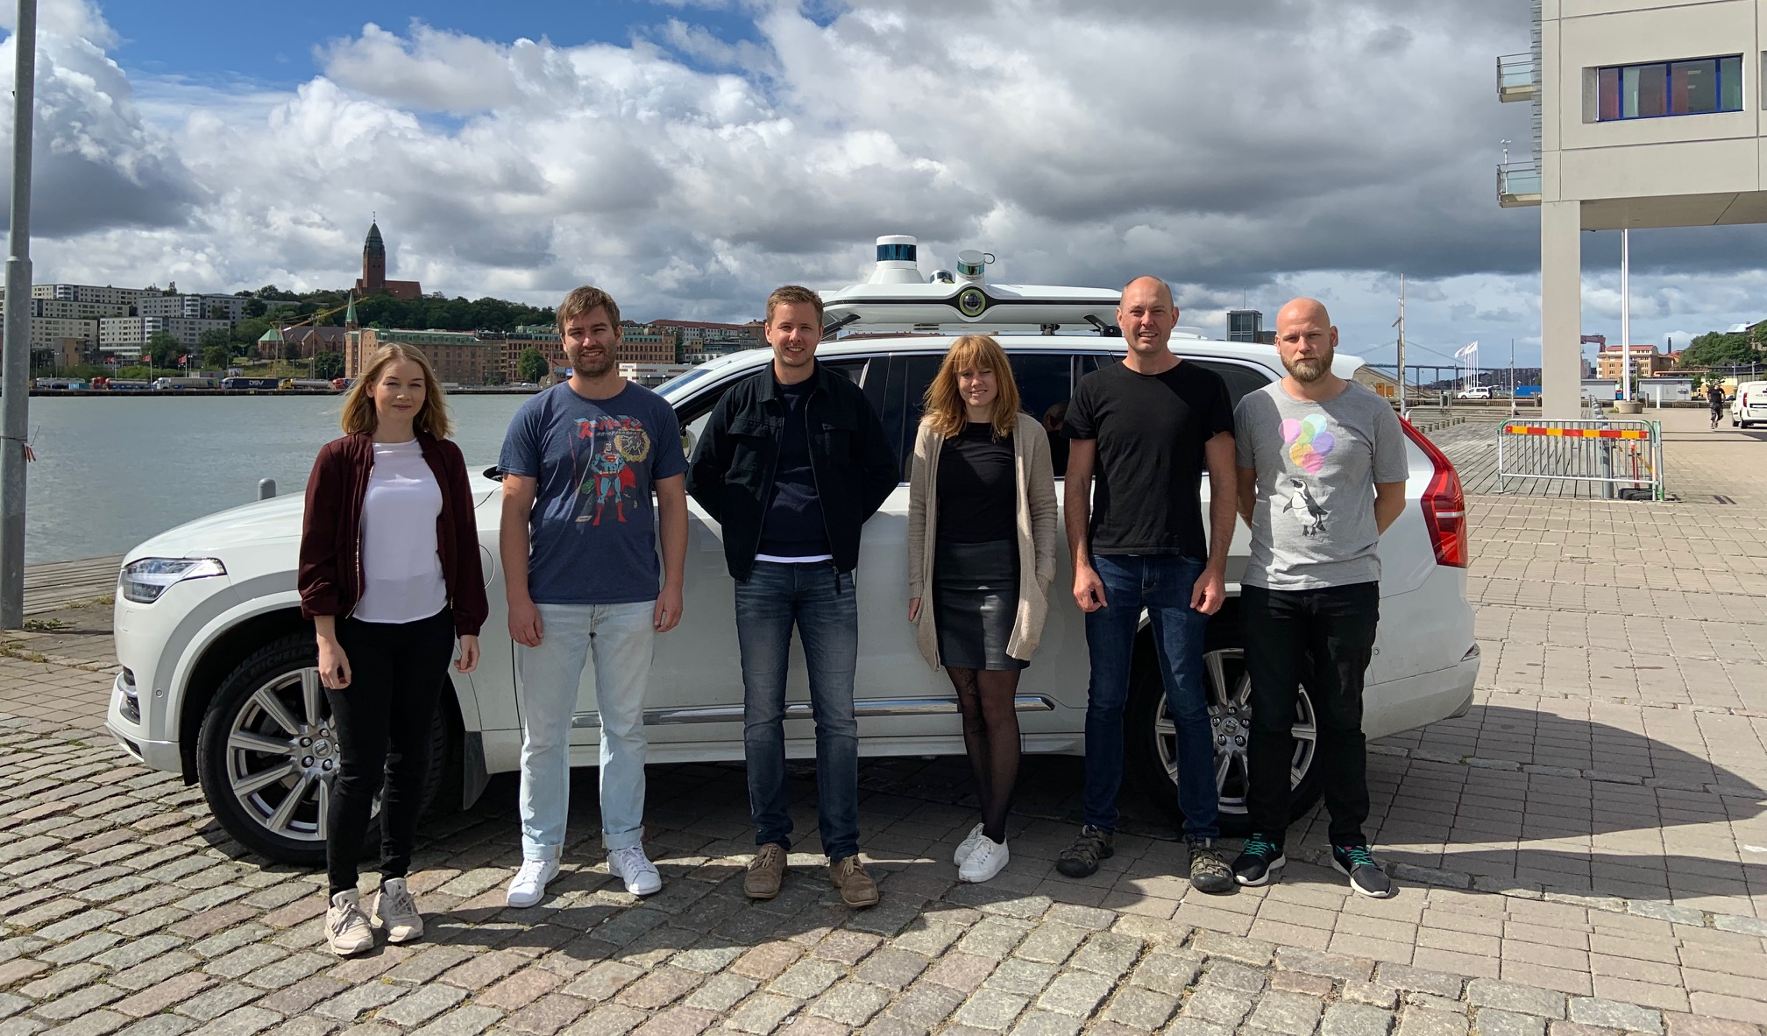

The Team

Slide 6
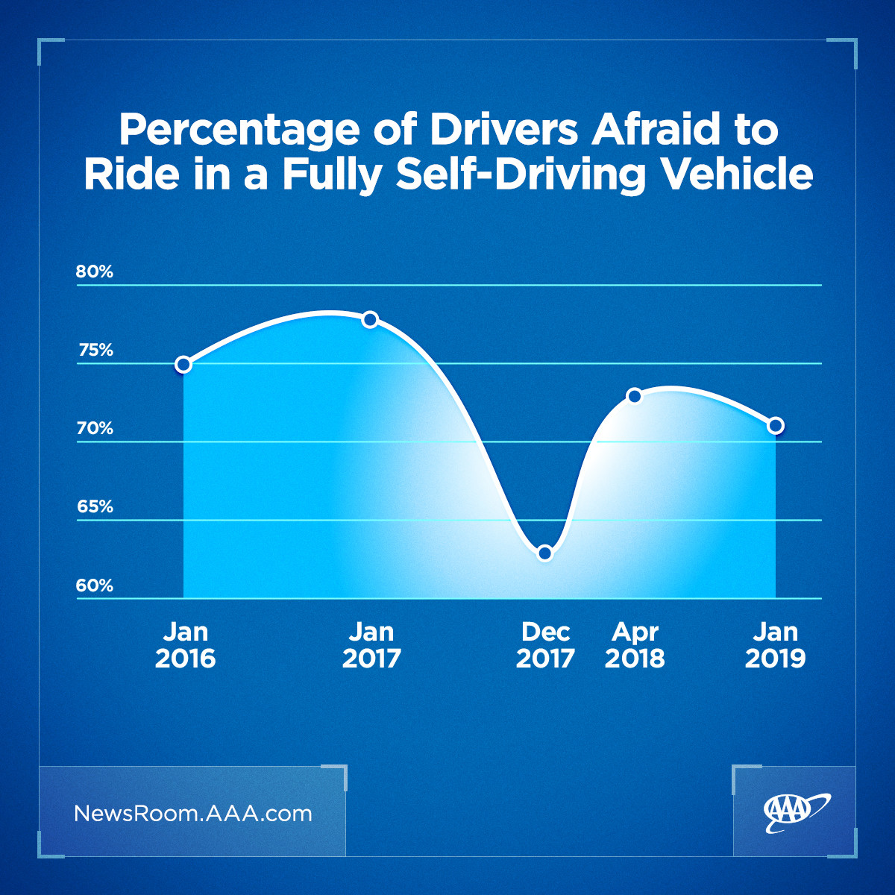
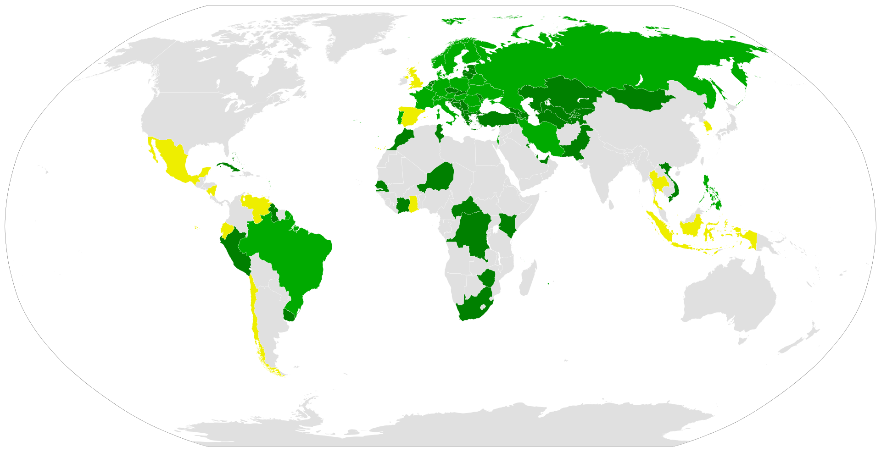
So we built an autonomous vehicle – What now?
How do we sell it?
Vienna Convention Article 8
Every moving vehicle OR COMBINATION OF VEHICLES SHALL HAVE A DRIVER.
Every driver shall at all timesbe able to control his vehicle or guide his animals.
Legal aspects
  We have to make sure our product abides by current and future laws set by legislators around the world.
Public opinion
  How do we make people ride the cars when an error might be fatal?
We have to prove to the world that our vehicles are safe!
Participation in the Vienna Convention

Slide 7
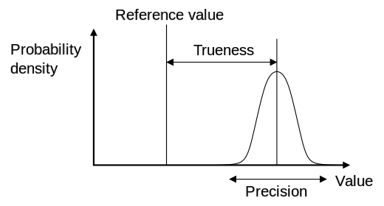
Previous experience tells us that
Functional Safety depends heavily on sensor performance
Specification from sensor suppliers reflects performance but is usually not objectively true
  Suppliers might overpromise
  Suppliers might not know the statistical performance of their sensors
Sensors that are to be used are sometimes not completed. Thus, no-one knows the true performance of the finished product
So how do you measure sensor accuracy?
Simple!
Compare sensor output to a reference

Slide 8

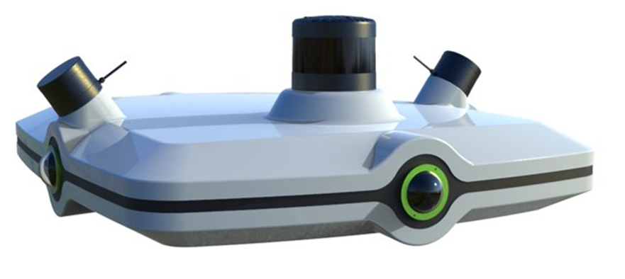
Our solution – Ground Truth Roofbox
Video introduction

Slide 9
Use cases and features
Reference sensor data is needed in real traffic for Zenuity to:
  Reduce manual verification
  Extend test-track verification to real-world
  Automate verification
  Perform statistical verification
The system provides 360 degree reference data of the environment of the vehicle and is easy to use
Collected data is automatically post processed offline, documented and formatted for use in verification and development
Inhouse-developed Roofbox and Software includes
  Lidar (range ~200 m)
  Cameras
  GPS/IMU
Sensors can be replaced or added to follow state-of-the art technologies
Camera FOV
Lidar FOV

Slide 10
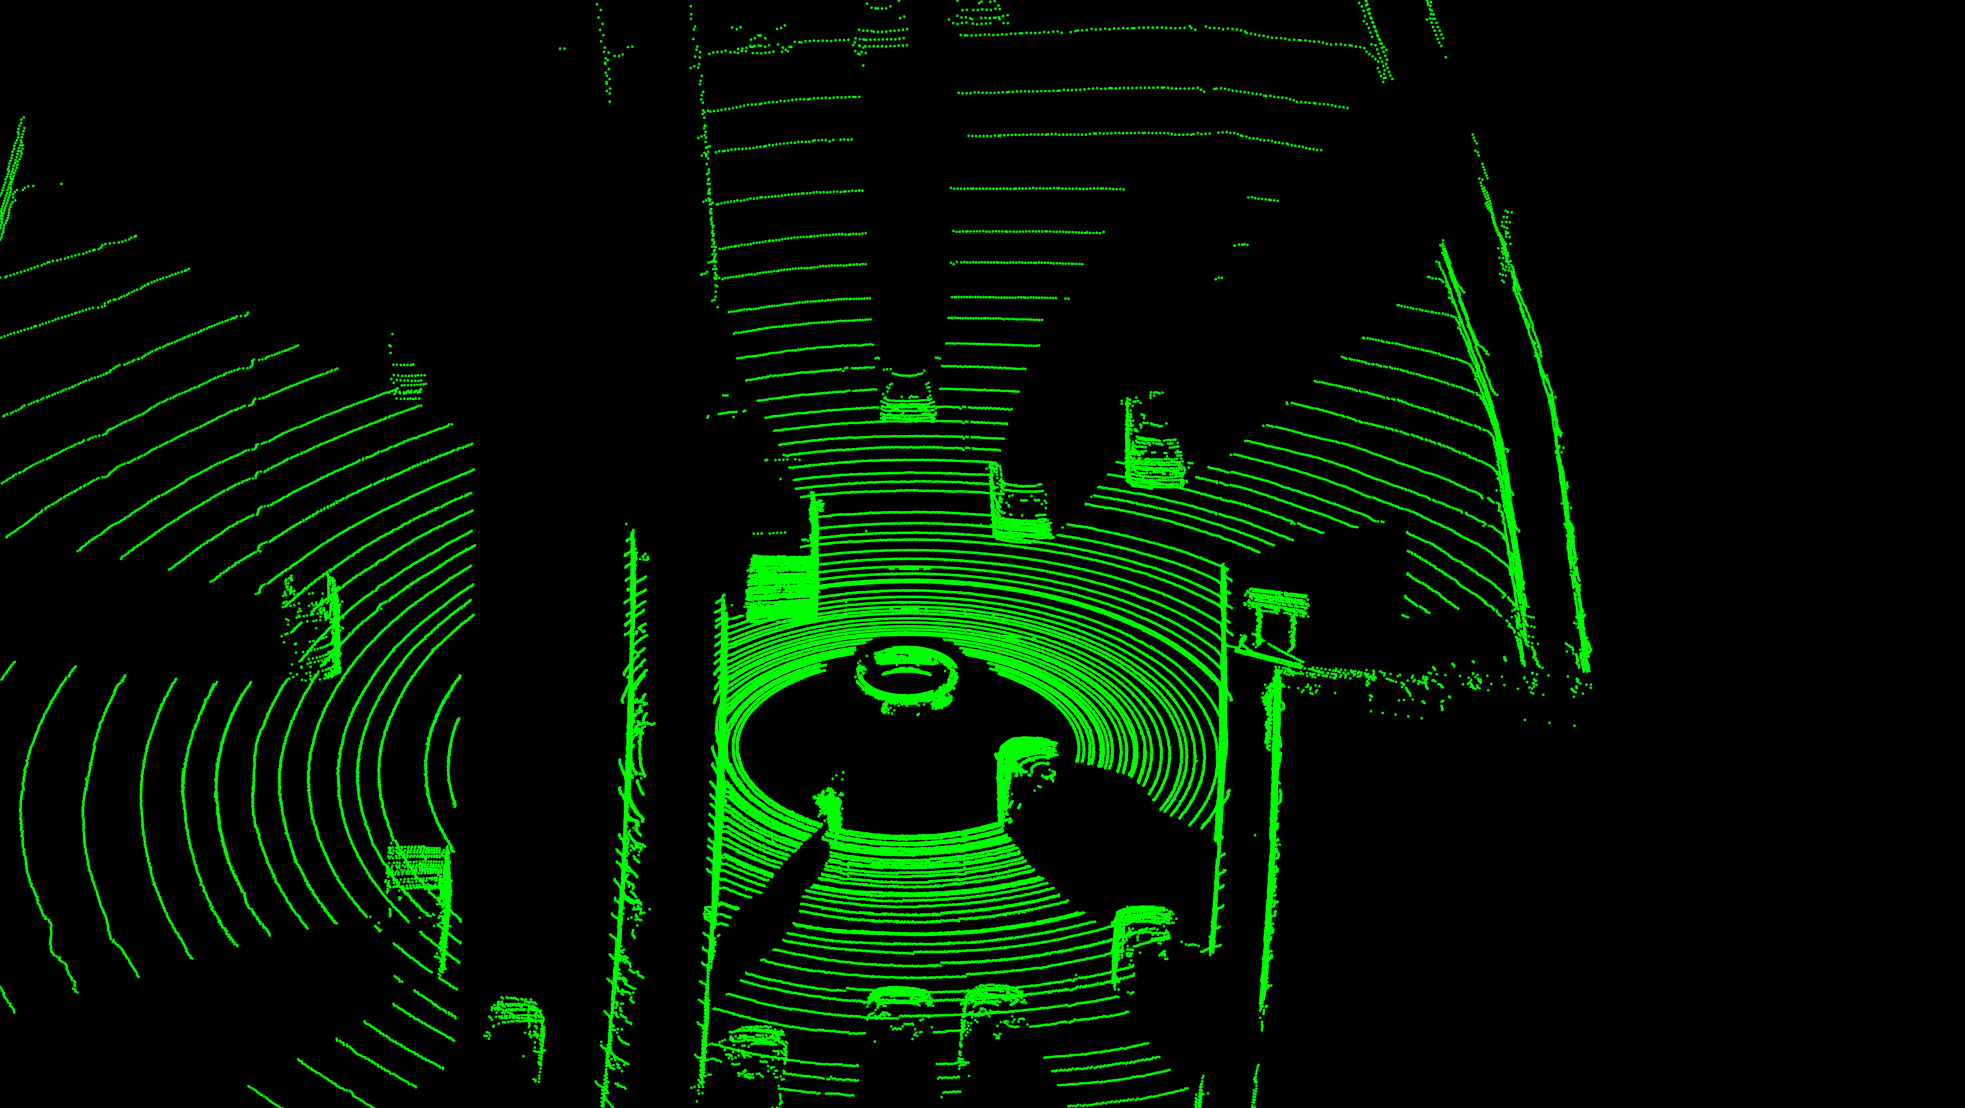
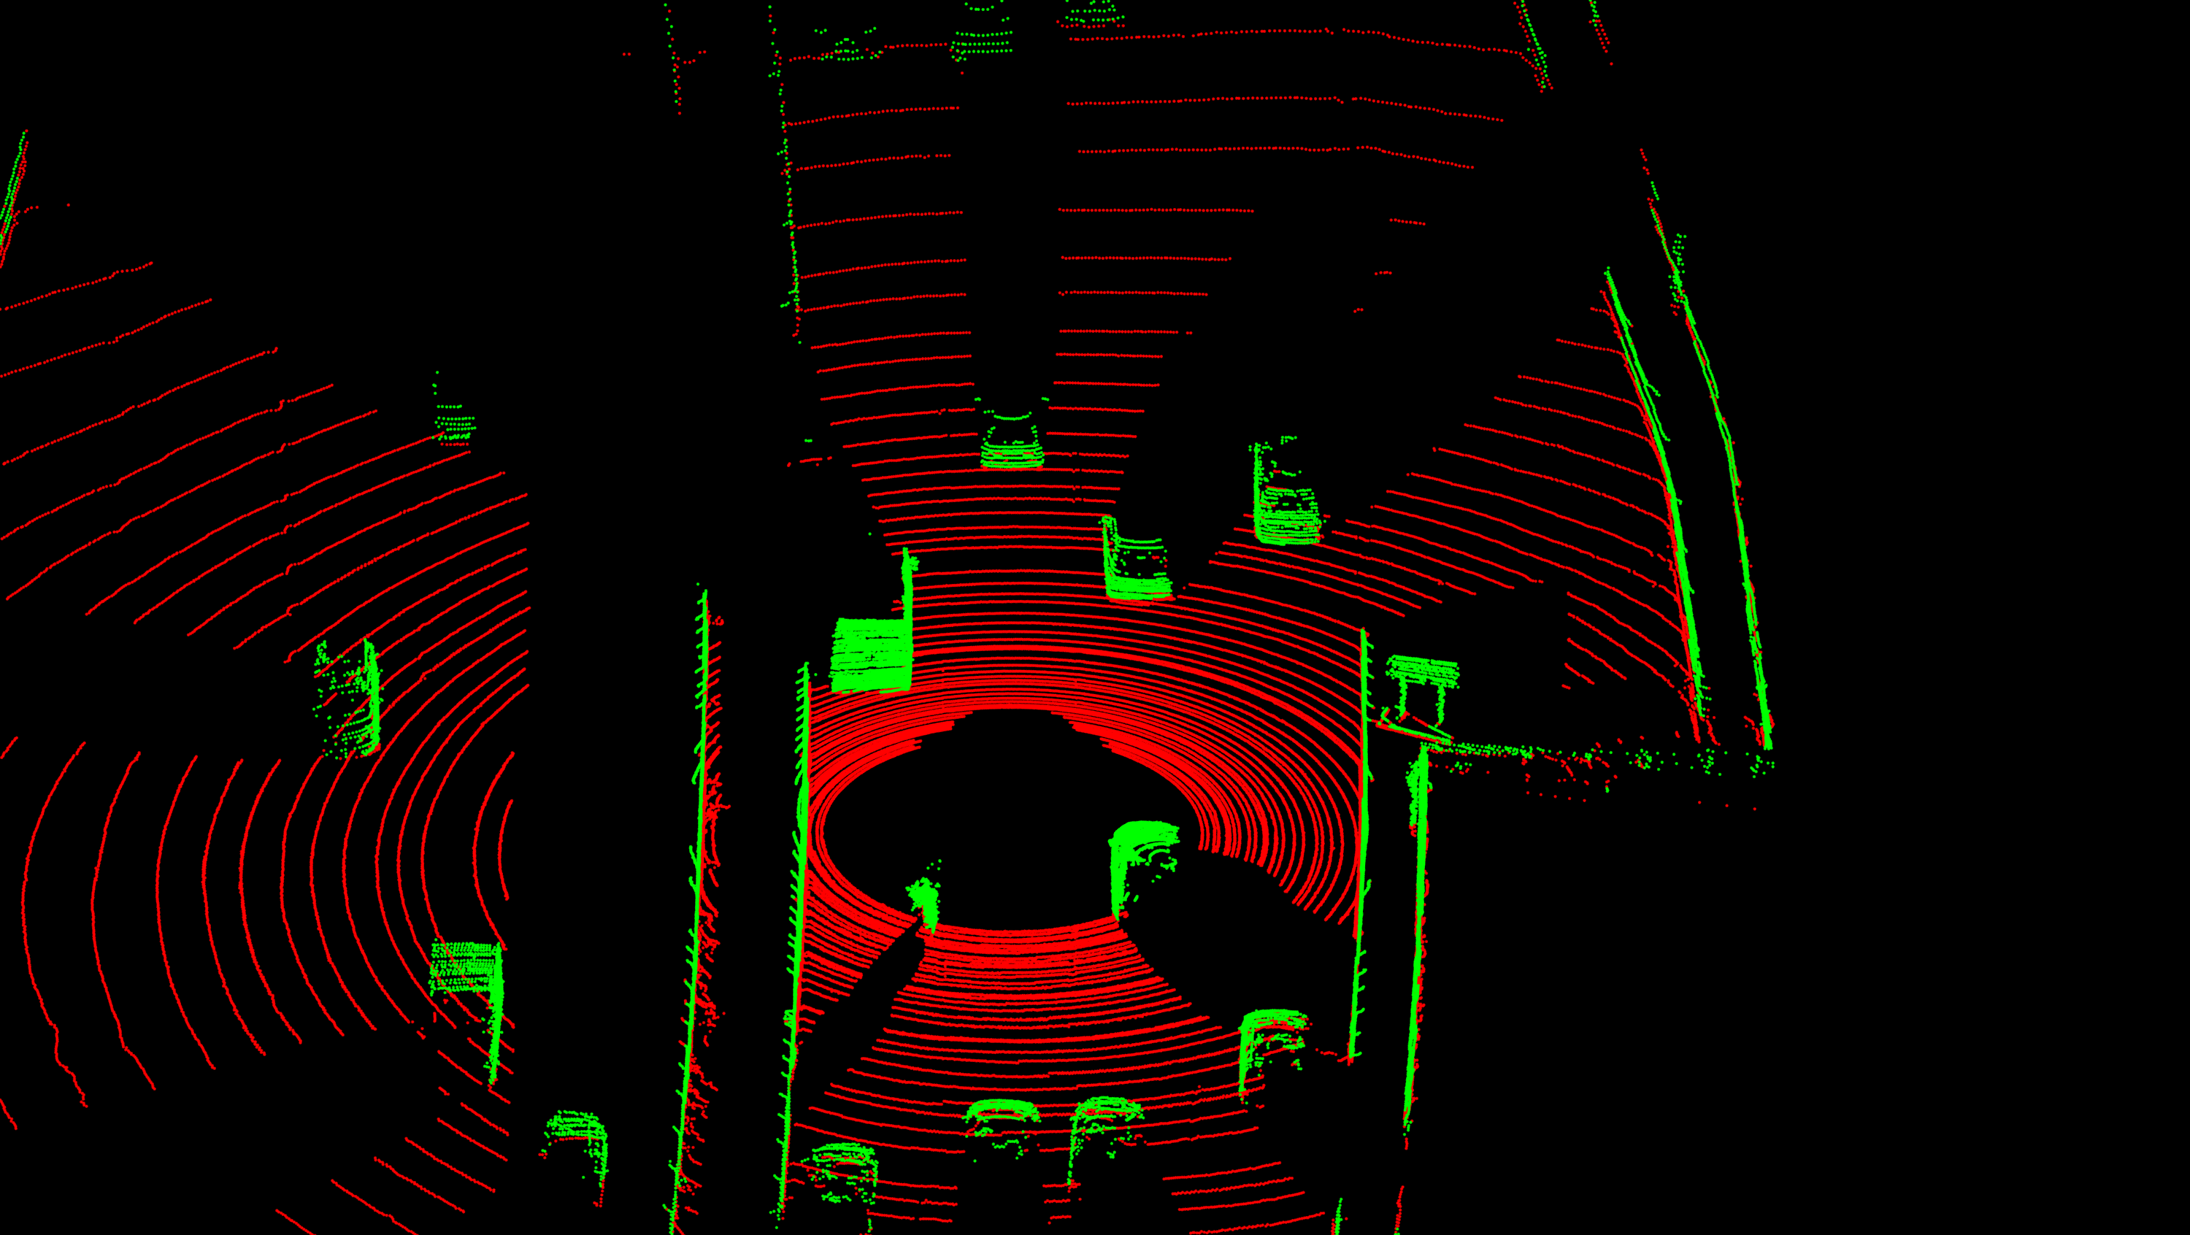
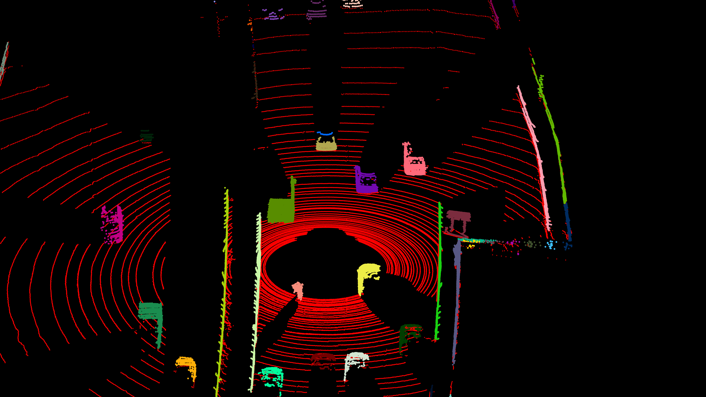
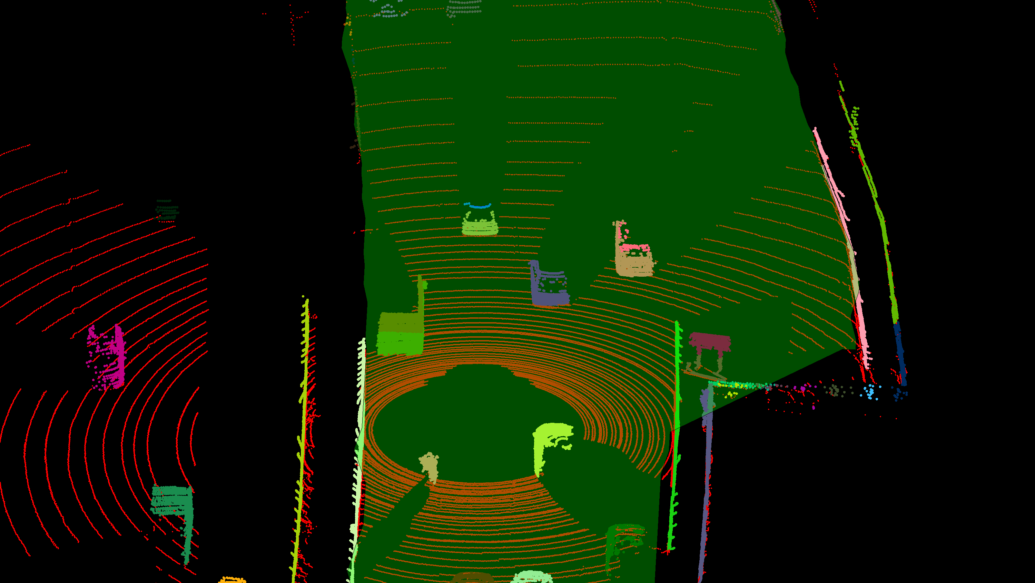
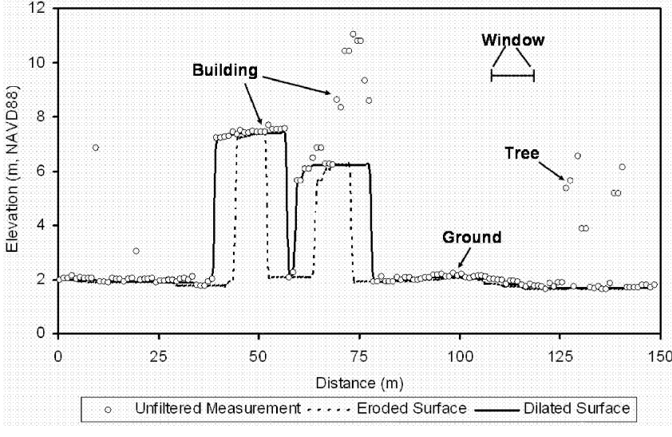
Object tracking – step by step
Raw pointcloud
Ground removal
Object segmentation
On road filtering
128 + 16 + 16 Lasers
10Hz rotations
~260000 points per rotation
X,Y,Z,Intensity
Adaptive progressive morphological filtering
Spherical conditional Euclidian clustering
Grid based greedy search for planar grids

Slide 11
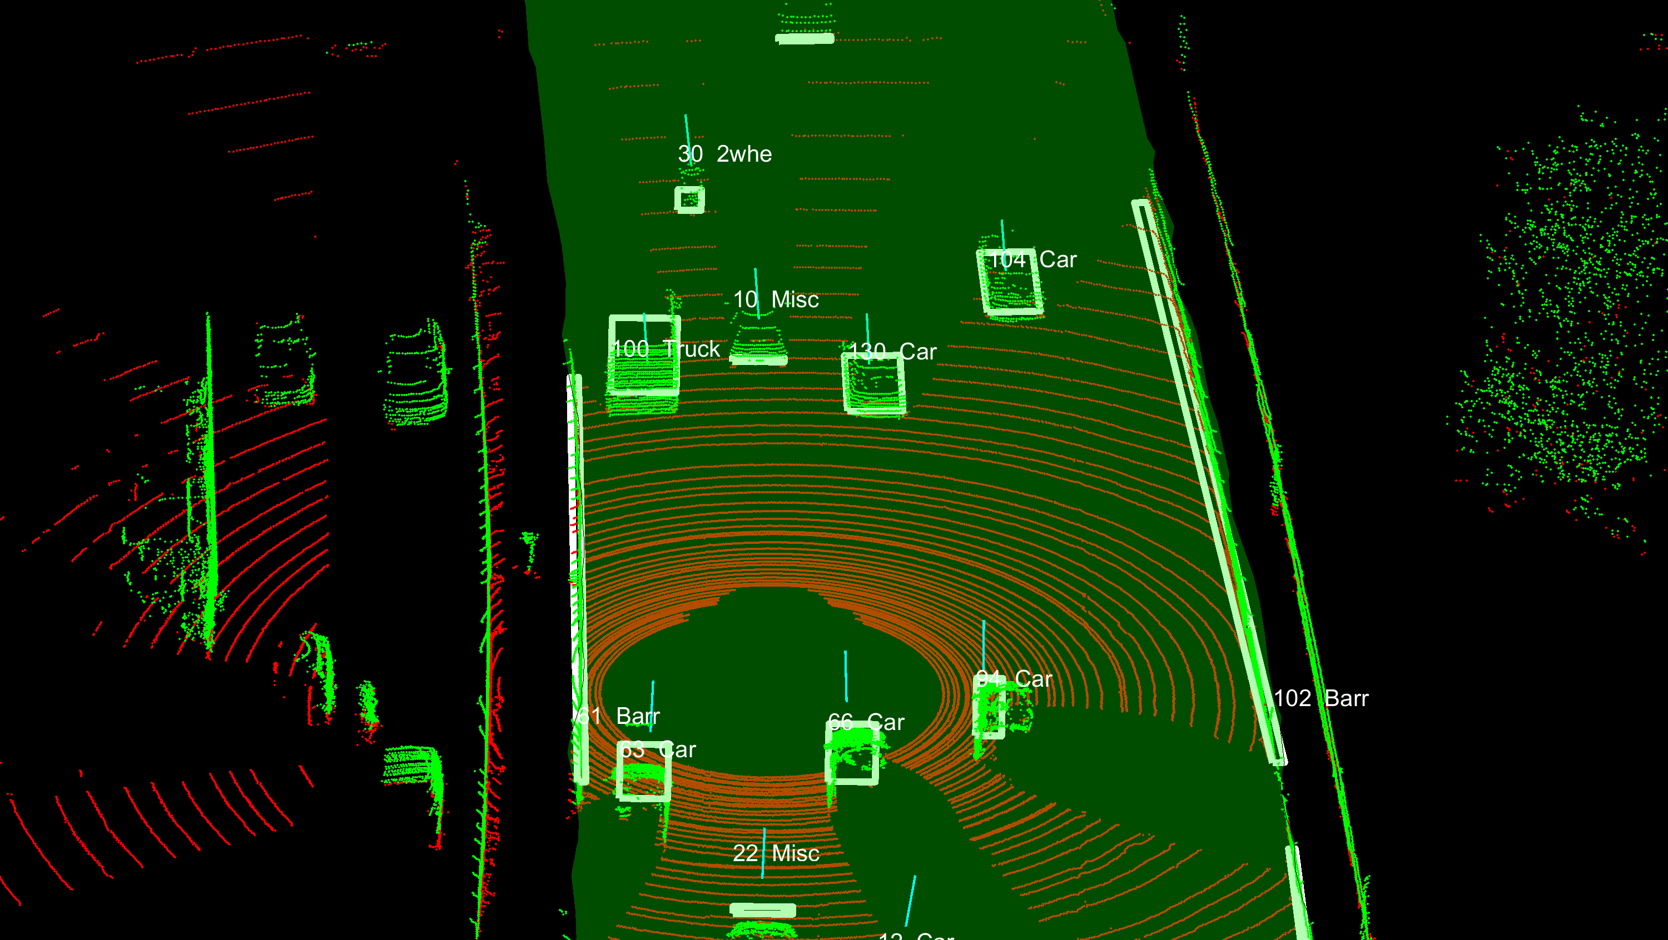
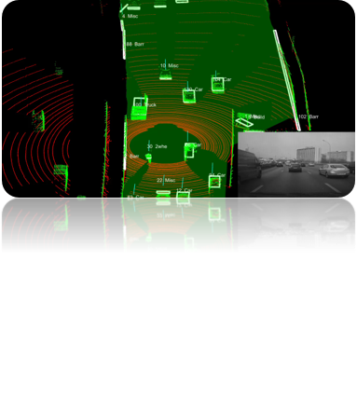
Object tracking – step by step
Initial classification
Tracking and post-classification
Support vector machine
  LibSVM
  Single-frame
  Geometry-based
Independent Forward and backward pass Kalman filter
Merge tracklets
Re-filter
Rauch-Tung-Striebel smoothing
Association based on weighted distance, classes, lifetime and other attributes
Post-classification to find most probable class during object lifetime

Slide 12
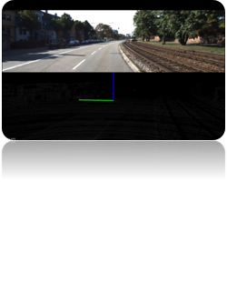
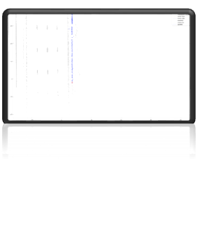
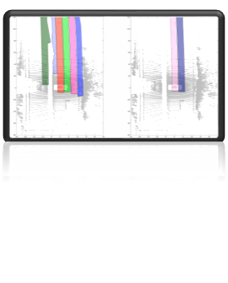
Lane detection – step by step
Lane marking detection
Lane marker tracking
Lane detection
Find lane marking points by looking at intensity
Track the center of lane markings to filter out connected lane marking segments
Use tracked lane centers to find where lanes are

Slide 13
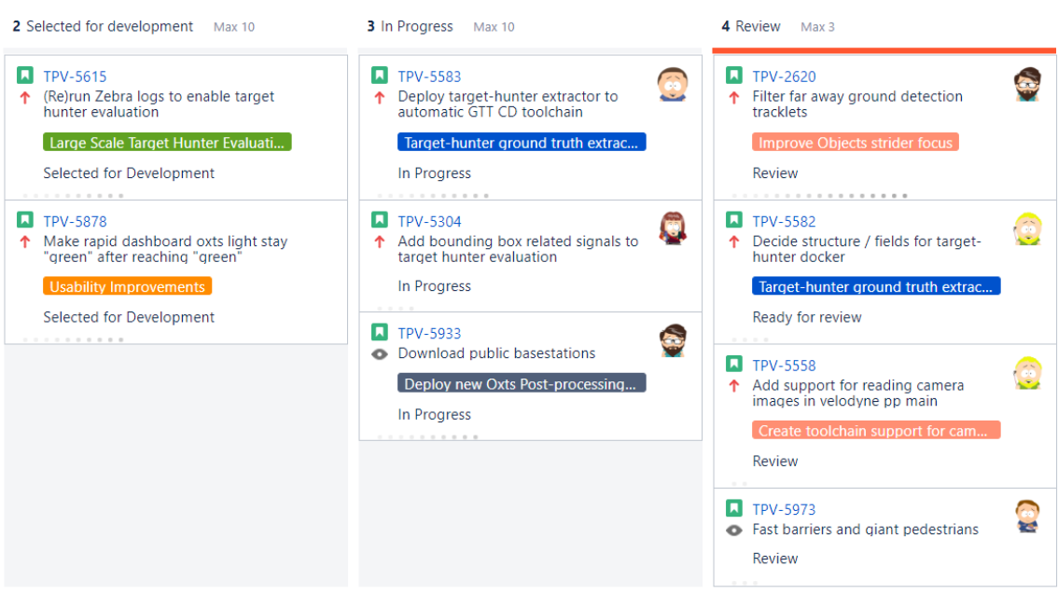
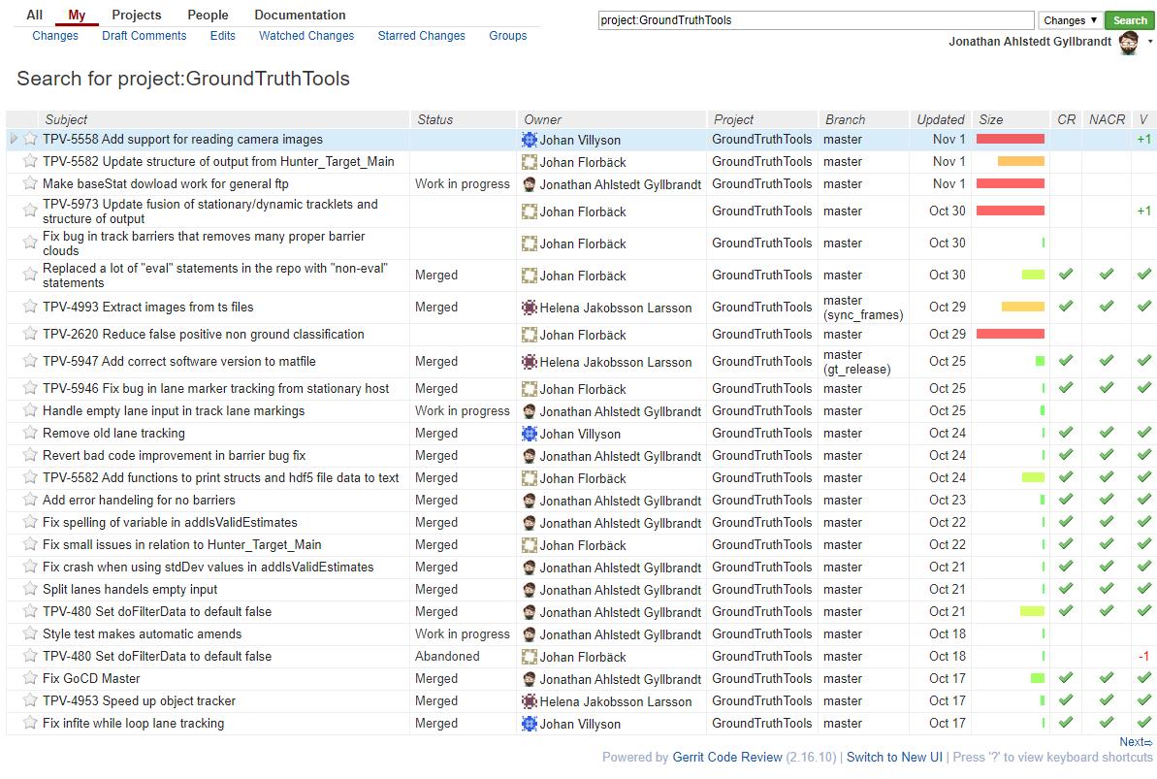

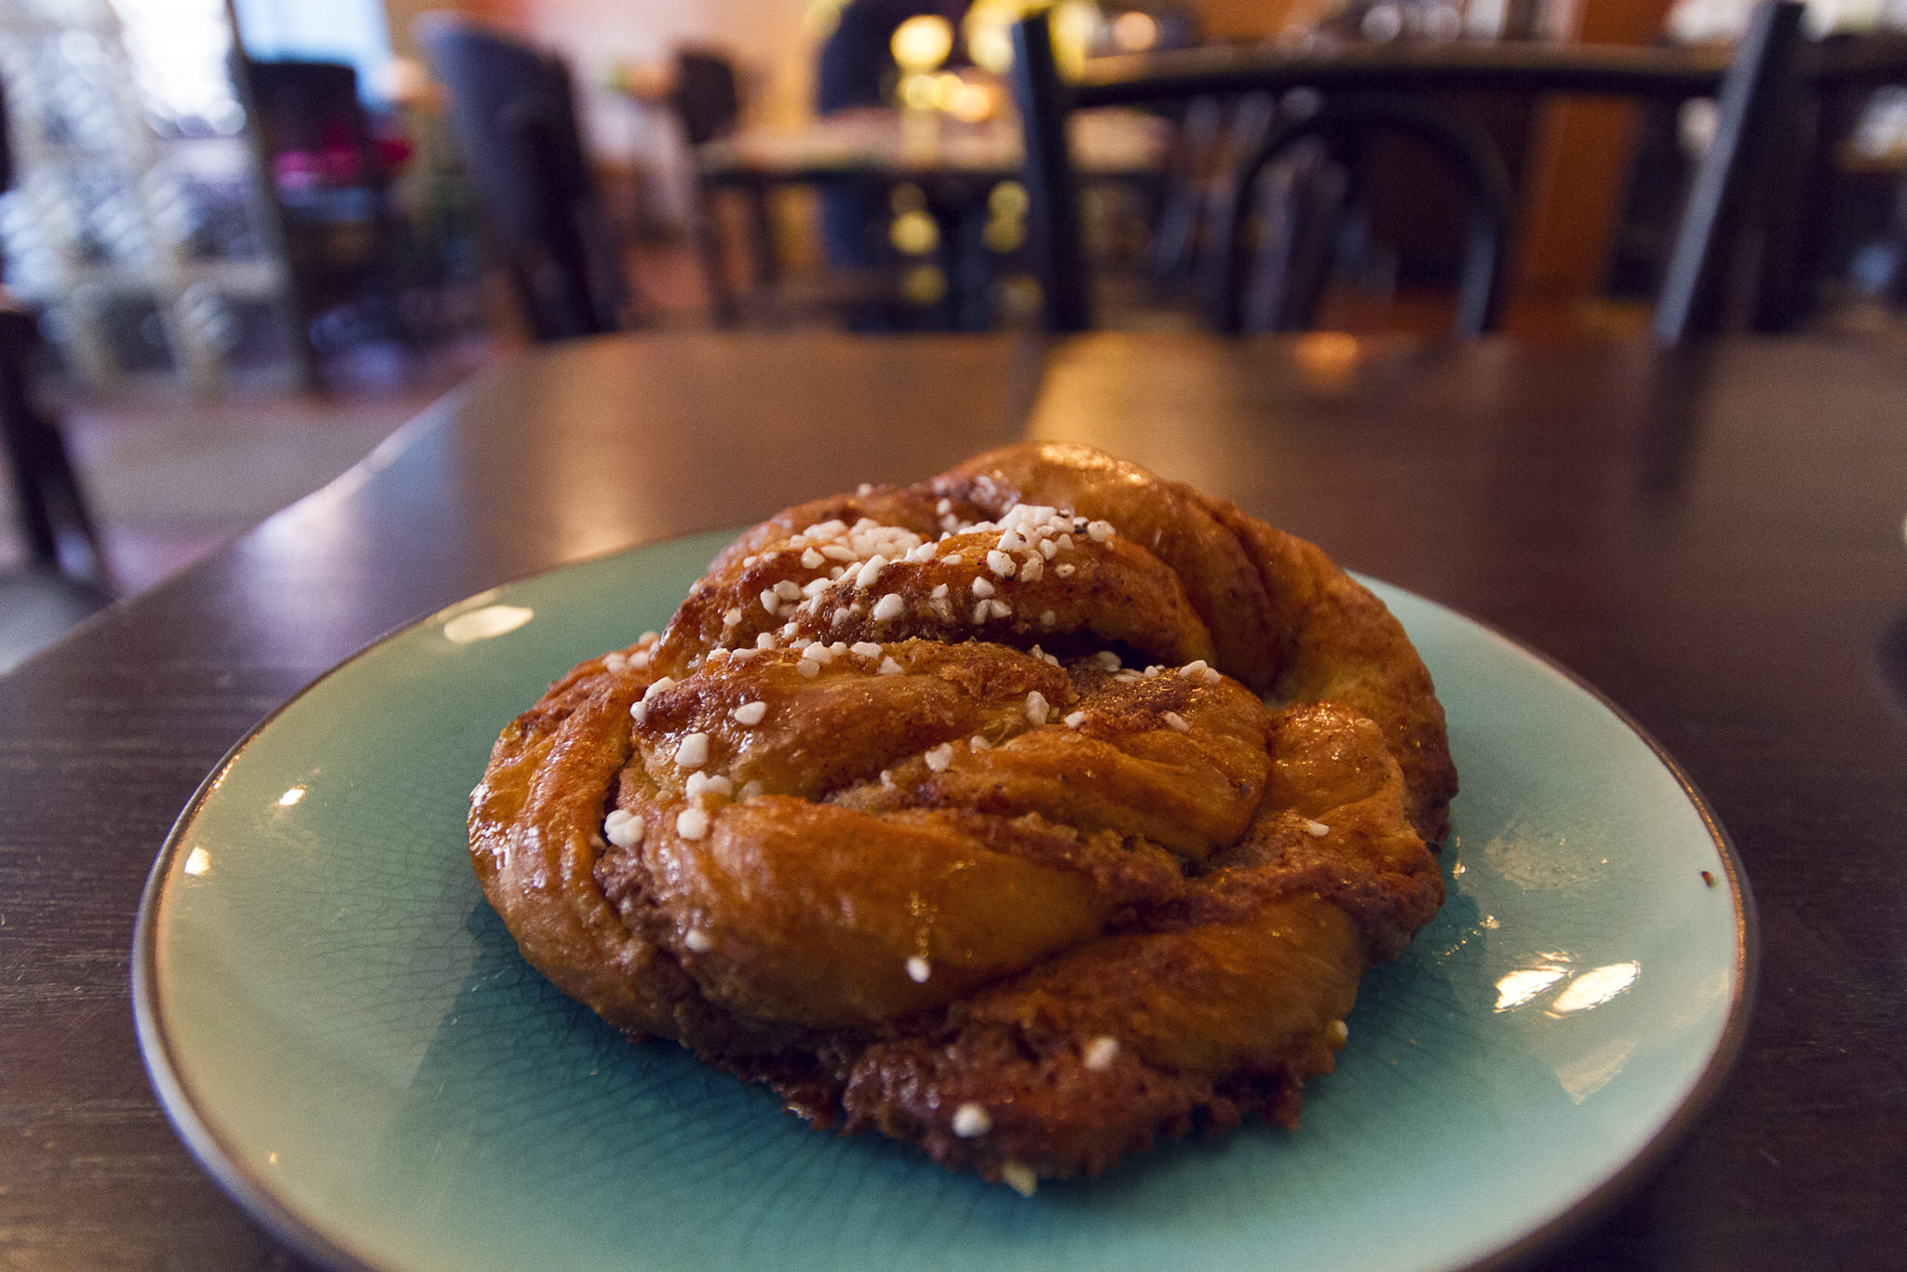
One day at work
Get to office at 8.00
  Review others code
  Answer emails
  Do some small patch
  Check in with other teams
Standup at 10.00
  Does someone need help?
  Any blockers?
  What will you work with today?
80% of team does lunch training 10.15-11.00
  Gym (Monday/Wednesday)
  Running (Tuesday/Thursday)
Lunch 11-12
Work 12-14
  Develop new feature
  Attend a meeting with another team
Team gets some air (and fika) 14-14.30
14.30-17~ Continue coding until I leave

Slide 14
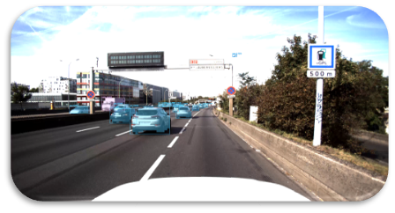
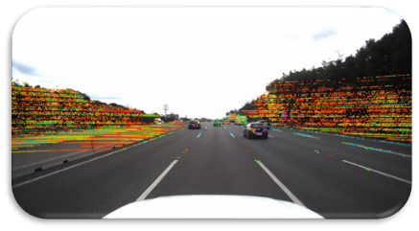
Upcoming work: Camera-Lidar Fusion
Tested running an open-source “Faster R-CNN Mask"
Trained on the COCO dataset.
Interpolated Lidar points onto camera image.
Calibration improvements possible

Slide 15
Q&A

